Slide 1
Political Ideology Detection
Annika Dahlmann, Divya Ramamoorthy, Ryan Song

Slide 2
Problem Description

Slide 3
Task Description
Identify political ideology based on public tweets before 2020 Presidential election
Twitter is a quick and easy source that influences elections
~ 70 million users in the United States
Input:
Naive Bayes and LogReg: frequency dictionary of words and corresponding counts
RNN: word embeddings
LSTM: vocabulary counts
Output: Republican or Democrat label
Notes:
DIVYA
train/val/test splits
20,000 training
TRAIN: 8,000 republican tweets + 8,000 democratic tweets
VAL: 2,000 republican tweets + 2,000 republican tweets
4,000 testing
2,000 republican tweets + 2,000 democratic tweets
Training details
Naive Bayes: log priors + log likelihood
Logistic Regression: sigmoid + gradient descent

Slide 4
Reference / Related Work
Notes:
DIVYA

Slide 5
Reference/Related Work
Prior work related to ideology detection:
RNN to capture syntactic (structure) and semantic (meaning) composition on ideologically charged sentences
Models using news articles, speeches as sources
Logistic Regression with Tweets
Twitter carries heavy social impact, its convenience factor for American voters makes it beneficial to use as data
RNN with sentence completion
Use one-hot encoding of data to predict most likely next word in a sentence
Notes:
DIVYA
[3] https://github.com/gabrielloye/RNN-walkthrough/blob/master/main.ipynba

Slide 6
Methodology

Slide 7
Methodology
2.5 million 2020 US Election tweets (Manch Hui’s 2020 Election Dataset)
Including tweets from both politicians and non-politicians
Balanced across classes
Preprocessing
(1) remove hyperlinks
(2) lowercase and tokenize text
(3) remove common words (“is”, “the”, etc.)
(4) stem words
(5) UNK tokens
Notes:
DIVYA
TweetTokenizer does same preprocessing

Slide 8
Example Data
status_id | created_at | text | party
x649659448751992833 | 2015-10-01 18:57:37 | Sgt. Martland should be commended - not punished! Proud to support @VernBuchanan &amp; @Rep_Hunter bill calling for his immediate reinstatement. | R
x1029813906234122242 | 2018-08-15 19:35:42 | 6 years ago, the Obama Administration gave #DREAMers the legal protection to stay in the United States. #DACA not only brought opportunity to these talented people, but also vitalized our communities and economy from their contributions to our society. DREAMers are #HereToStay.https://t.co/DjSRRzzr4T | D
Notes:
ANNIKA
Mention how hashtags are commonly used in tweets and 2nd example has hyperlink which provides no information about the party

Slide 9
LogReg+NB Pipeline
Data
Training
Frequency Dictionary
(word, party) | count
(“economy”, 1) | 4
… | …
Model
preprocess
Evaluation
Validation
Testing
Notes:
ANNIKA

Slide 10
LSTM Pipeline
Data
Training
Frequency Dictionary
 | word count 1 | word count 2 | …
tweet1 | 51 | 4
tweet2 | 120 | 0
…
Model
preprocess
Evaluation
Testing
Notes:
RYAN
Preprocess = TweetTokenizer

Slide 11
LSTM Architecture
Layers
Embedding Layer
Conv. layer + ReLU
Max Pooling Layer
LSTM Layer
Dense/Sigmoid Layer
LSTM Layer contains 100 units
Notes:
RYAN

Slide 12
Results

Slide 13
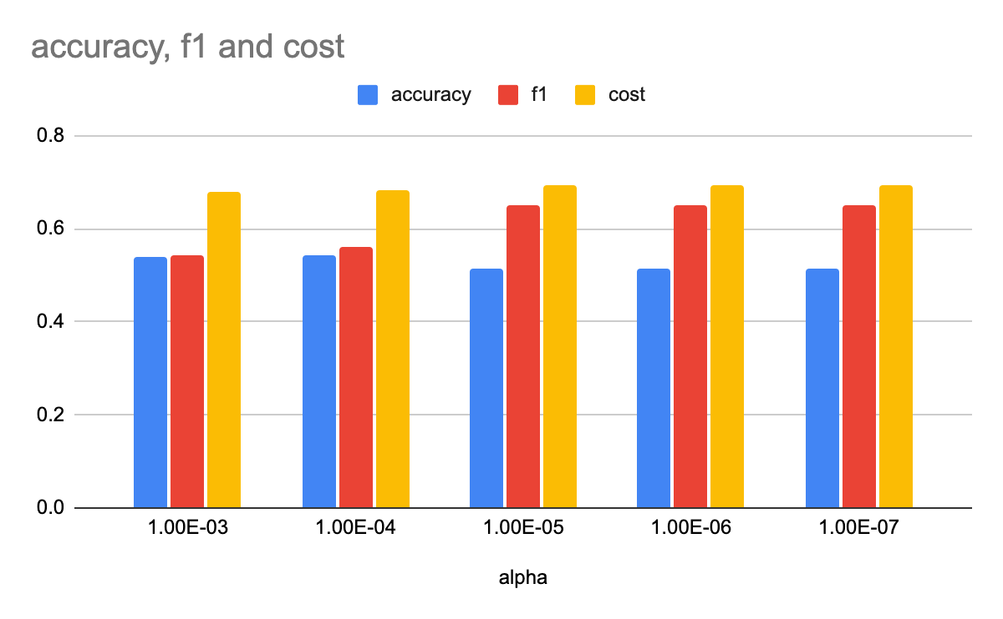
Results
LogReg
Best Accuracy: 54.32%
Naive Bayes
Accuracy: 53.13%
LSTM
Test Accuracy: 67.42%
Batch Size: 64
Loss Function: Binary Cross-Entropy
LR: 1e-5
Weight Decay: 1e-4
Notes:
RYAN
Discuss performance and insight analysis

Slide 14
Further Work

Slide 15
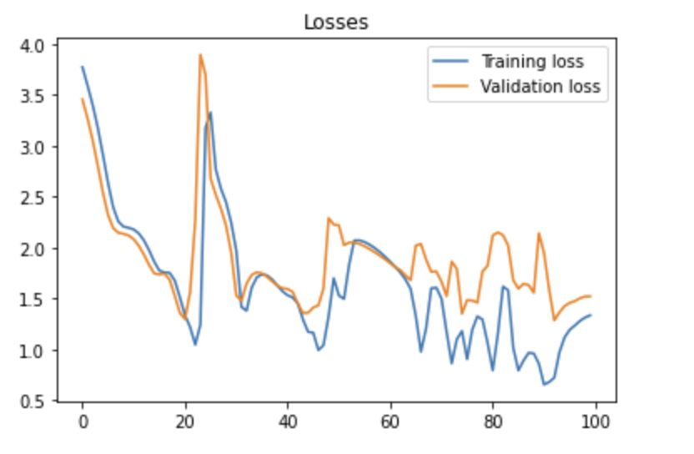
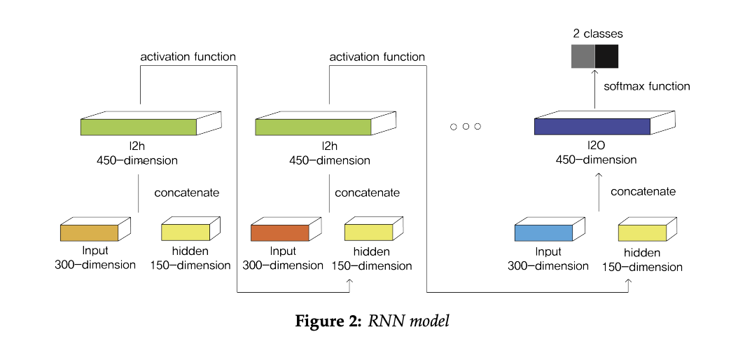
RNN Architecture and Results
100 epochs, weight decay=0.0001, learning rate=0.01
accuracy=0.4887, f1_score=0.6566
Notes:
ANNIKA
Talk about next steps – hyperparameter tuning (weight decay, learning rate, number of epochs, hidden layer size) to improve accuracy/loss, explore LSTM more?

Slide 16
Thanks!

